Slide 1


Image Scraping And Classification Project
Submitted By-
SUJIT KUMAR

Slide 2
Introduction
Images are one of the major sources of data in the field of data science and AI. This field is making appropriate use of information that can be gathered through images by examining its features and details. We are trying to give you an exposure of how an end to end project is developed in this field.
The idea behind this project is to build a deep learning-based Image Classification model on images that will be scraped from e-commerce portal. This is done to make the model more and more robust.
The Project consists of two phases:
Data Collection Phase
Model Building Phase

Slide 3
Data Collection Phase
We have to scrape images from e-commerce portal, Amazon.com. The clothing categories used for scraping will be:
Sarees (women)
Trousers (men)
Jeans (men)
First we have scraped link to those images using Selenium framework and then created directories to download and save scraped images. The categories are defined as Jeans: 0, Sarees: 1, Trousers: 2.
We have scraped 431 images for each category i.e. total of 1239 images is collected. Then I have created a directory to download images.

Slide 4
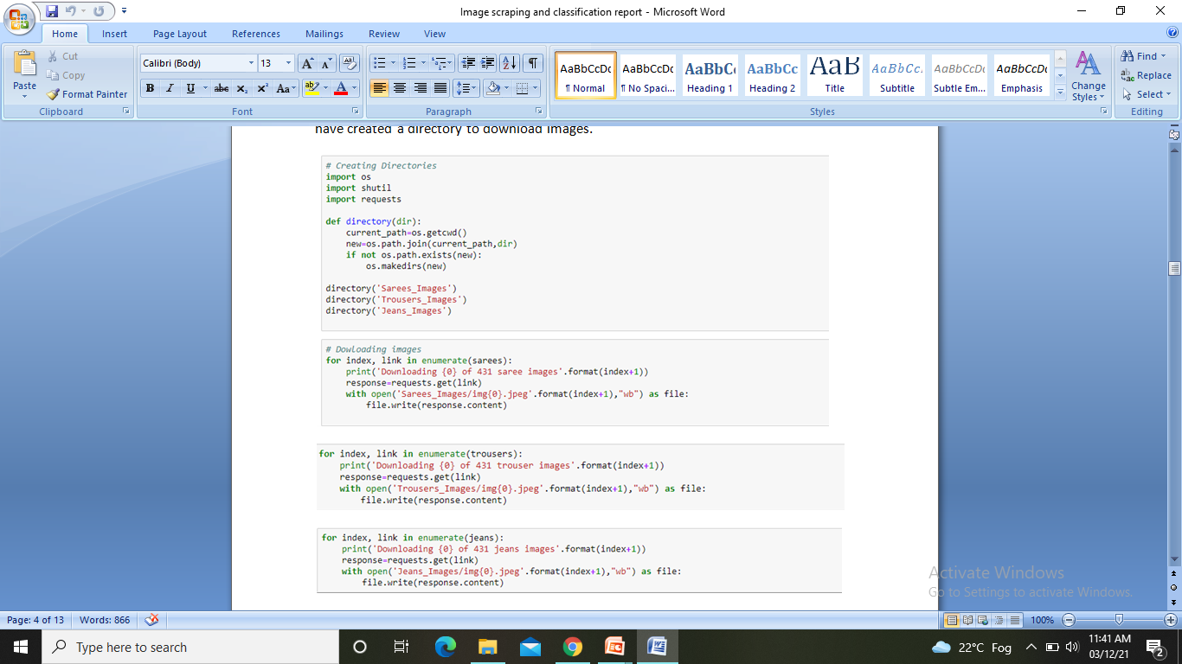

Slide 5
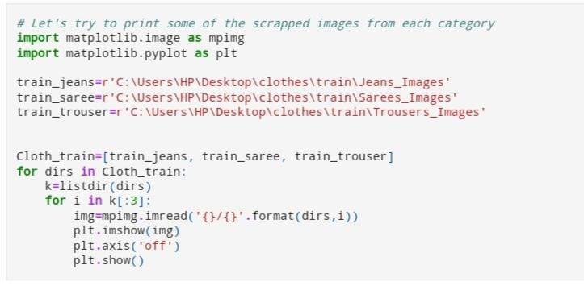
Displaying The Images
Displaying The Scraped Images

Slide 6
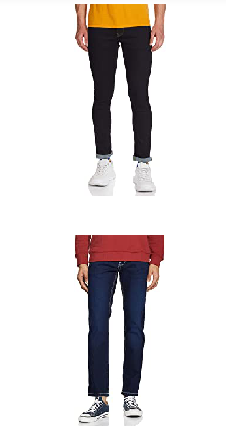
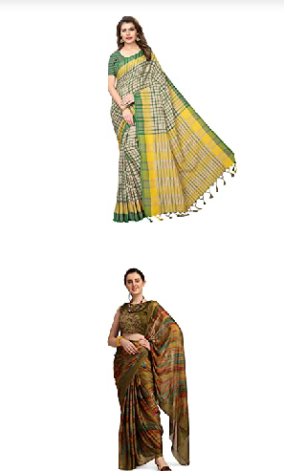
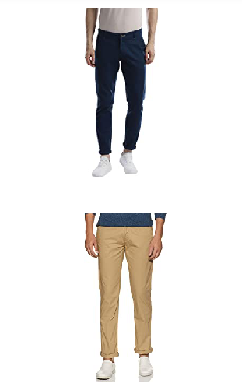
Jeans Sarees Trousers

Slide 7
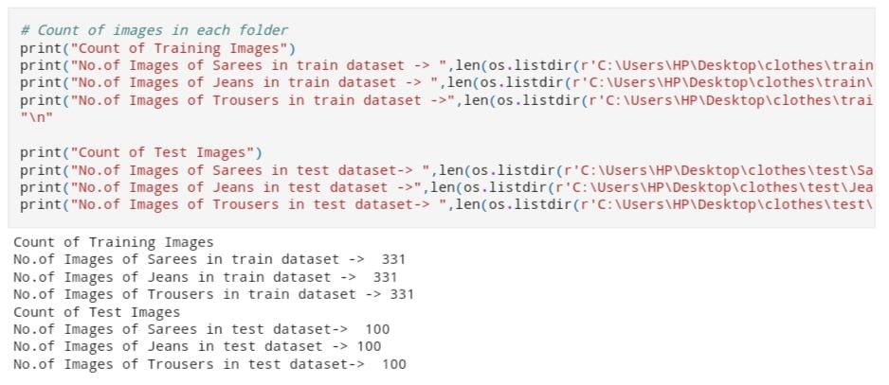
Count Of Images In Each Folder

Slide 8
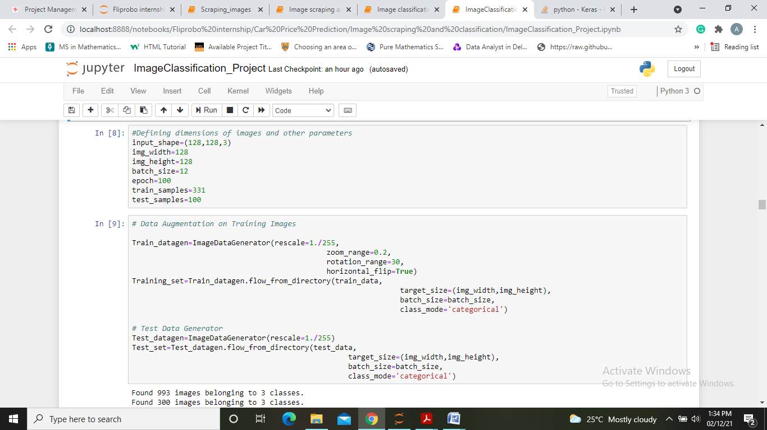
Model Building Phase
After the data collection and preparation is done, I have build an image classification model that will classify between these 3 categories mentioned above.
First we will be defining dimensions of images and other parameters too. Then for data augmentation we defined training and testing set.

Slide 9
Data Augmentation

Slide 10
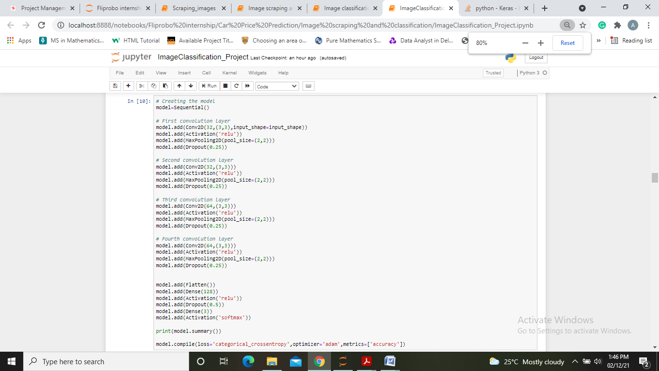
Created A Model Using Convolution Neural Network

Slide 11
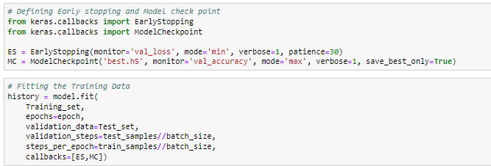
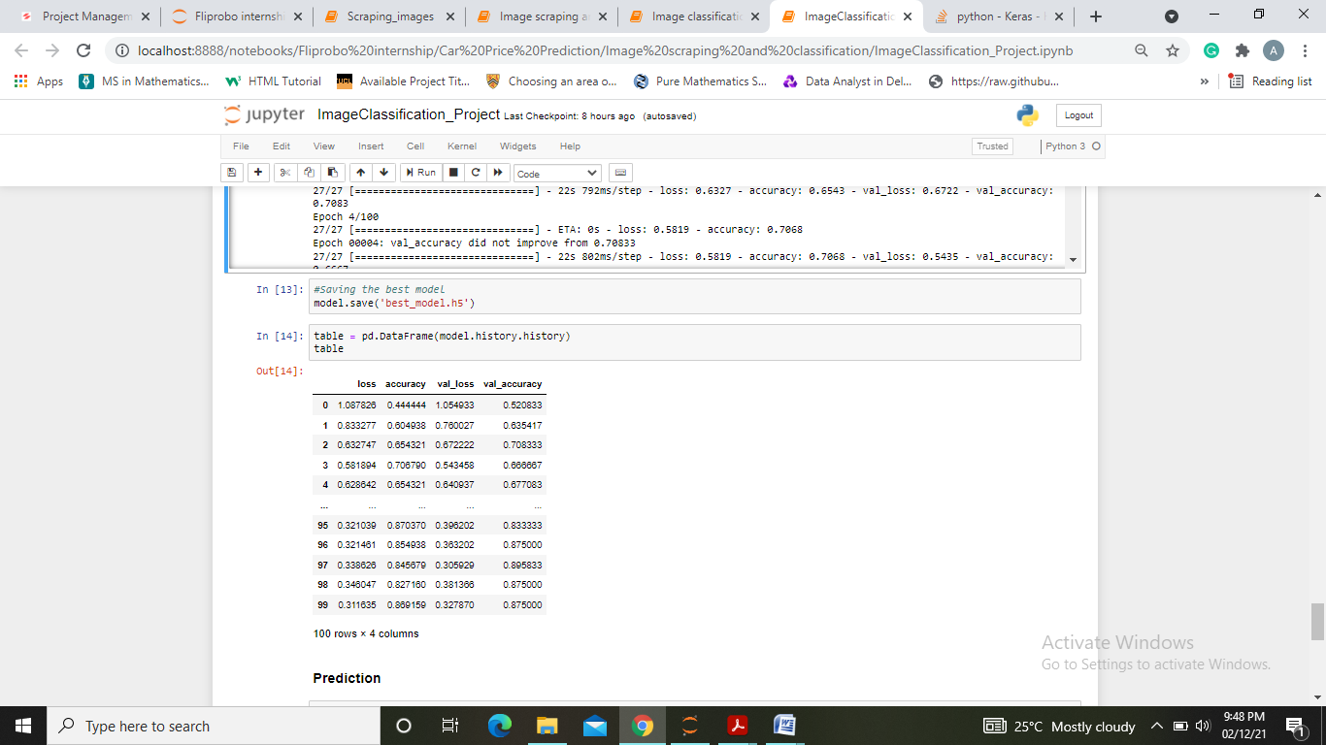
Now we will define early stop criteria and model check point further saving the model as “best_model.h5”.

Slide 12
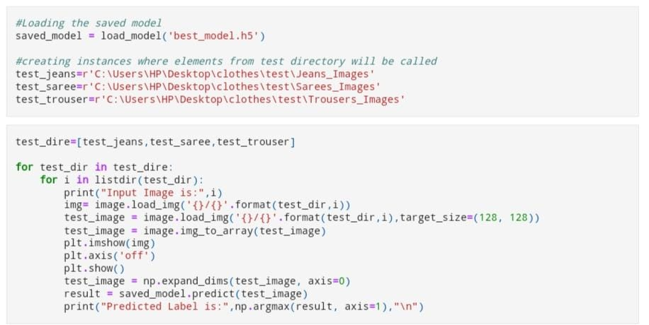
Prediction

Slide 13
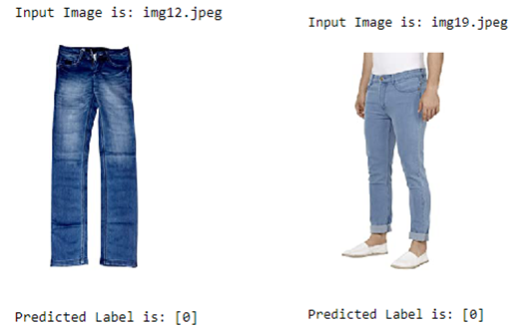
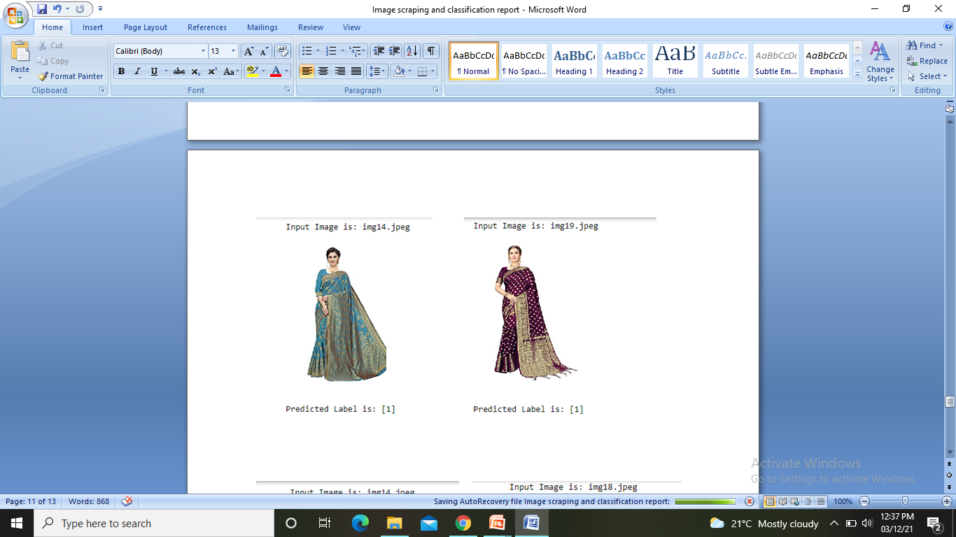
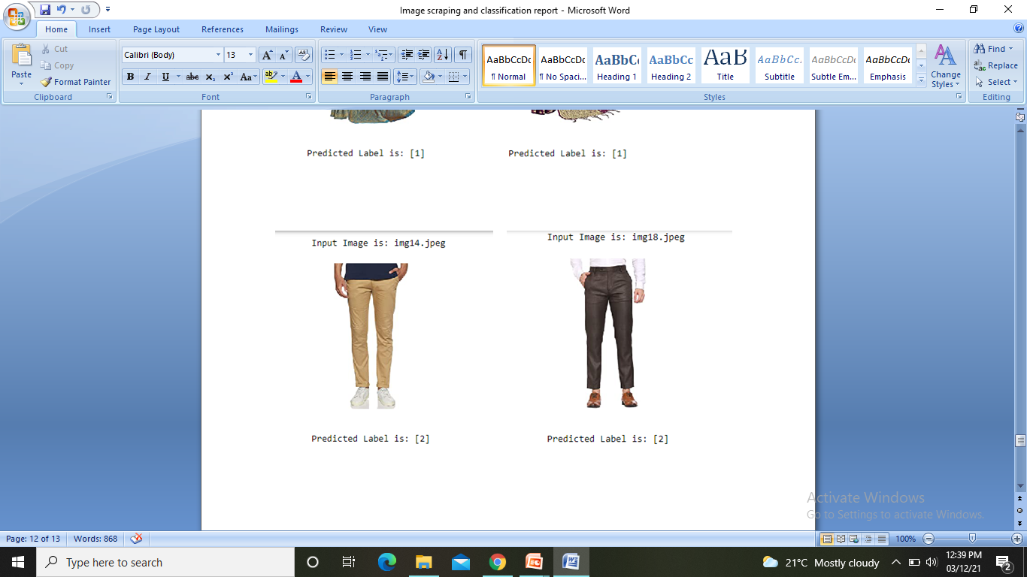
Results

Slide 14
Conclusion
KEY FINDINGS AND CONCLUSIONS OF THE STUDY
In conclusion, this project is about image classification by using deep learning via framework TensorFlow. The roles of epochs in
CNN was able to control accuracy and also prevent any problems such as overfitting. Thus we were able to classify the three categories of images with an accuracy of 86.4%.
LEARNING OUTCOMES OF THE STUDY IN RESPECT OF DATA SCIENCE
In this project I was able to learn about Deep Neural Networks and Convulation Neural Network. I also learned techniques to scrap and download images in the specified directory using code.

Slide 15
LIMITATIONS OF THIS WORK
AND SCOPE FOR FUTURE WORK
While we couldn’t reach out goal of 100% accuracy in image classification, we did end up creating a system that can with enough time and data get very close to that goal. As with any project there is room for improvement here.
This model can further be improved with the addition of more algorithms into it. However, the output of these algorithms needs to be in the same format as the others.
Once that condition is satisfied, the modules are easy to add as done in the code. This provides a great degree of modularity and vesatility to the project.

Slide 16


